Slide 1


LCAP
21-22 Review
22-23 Revision
UPCS at CSUCI

Slide 2

LCAP OVERVIEW
The LCAP is a three-year plan that describes the goals, actions, services, and expenditures to support positive student outcomes that address state and local priorities. The LCAP provides an opportunity for local educational agencies (LEAs) to share their stories of how, what, and why programs and services are selected to meet their local needs. The components of the LCAP for the 2022–2023 LCAP year must be posted as one document assembled in the following order:
LCFF Budget Overview for Parents
Supplement to the Annual Update to the 2021–22 LCAP
Plan Summary
Engaging Educational Partners
Goals and Actions
Increased or Improved Services for Foster Youth, English Learners, and Low-income students
Action Tables
Instructions

Slide 3
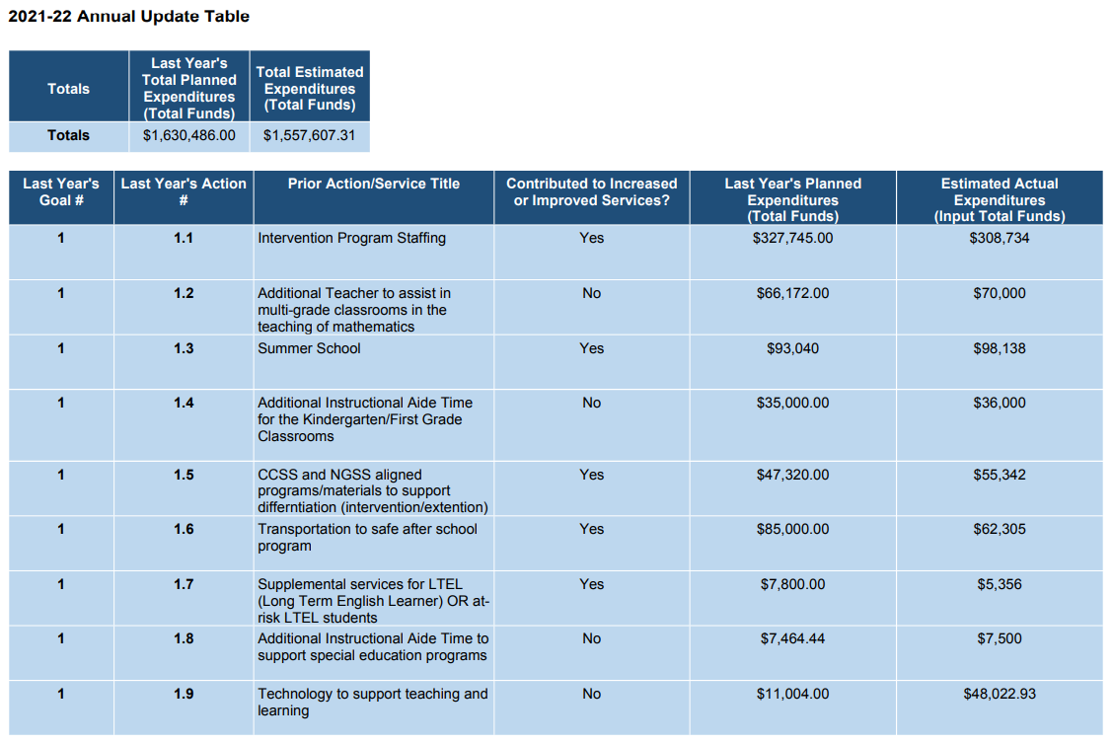

Slide 4
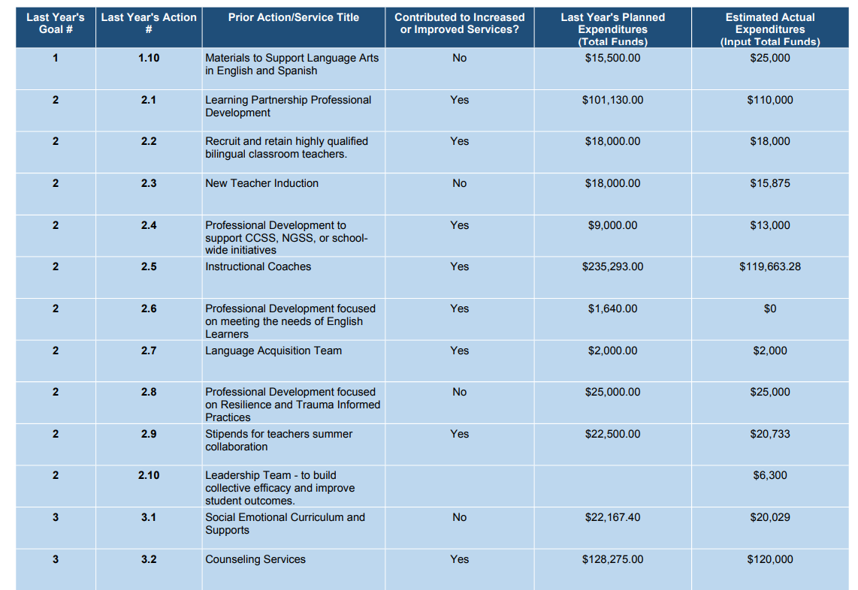

Slide 5
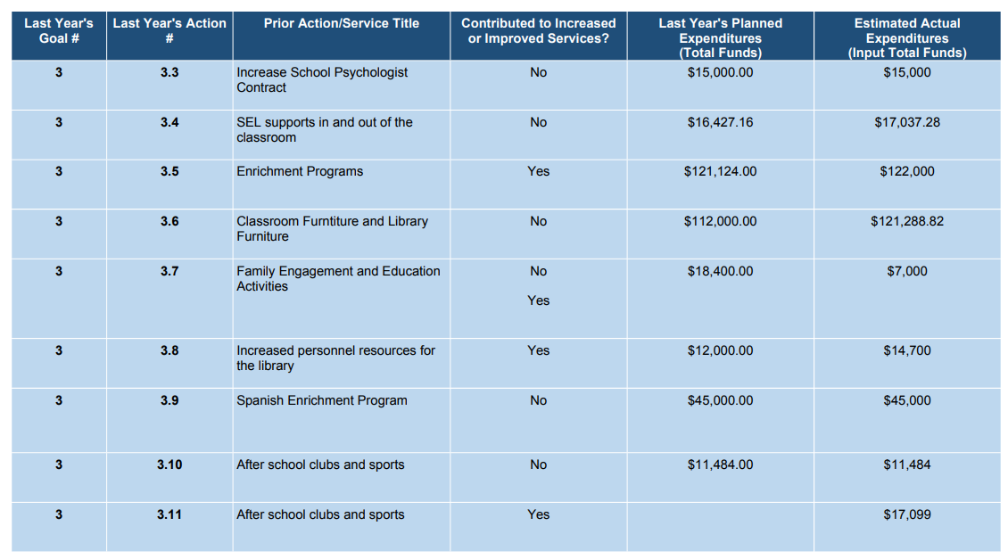

Slide 6
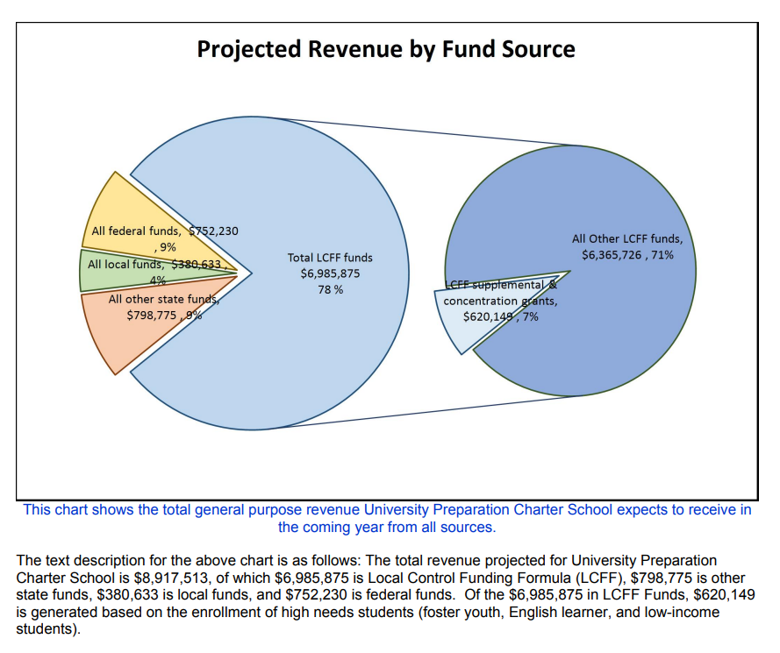
THE BUDGET OVERVIEW FOR PARENTS 22-23
The total revenue projected for UPCS is $8,917,513, of which $6,985,875 is Local Control Funding Formula (LCFF), $798,775 is other state funds, $360,633 is local funds, and $752,230 is federal funds. Of the $6,985,875, LCFF funds, $620,149 is generated based on the enrollment of high needs students.

Slide 7
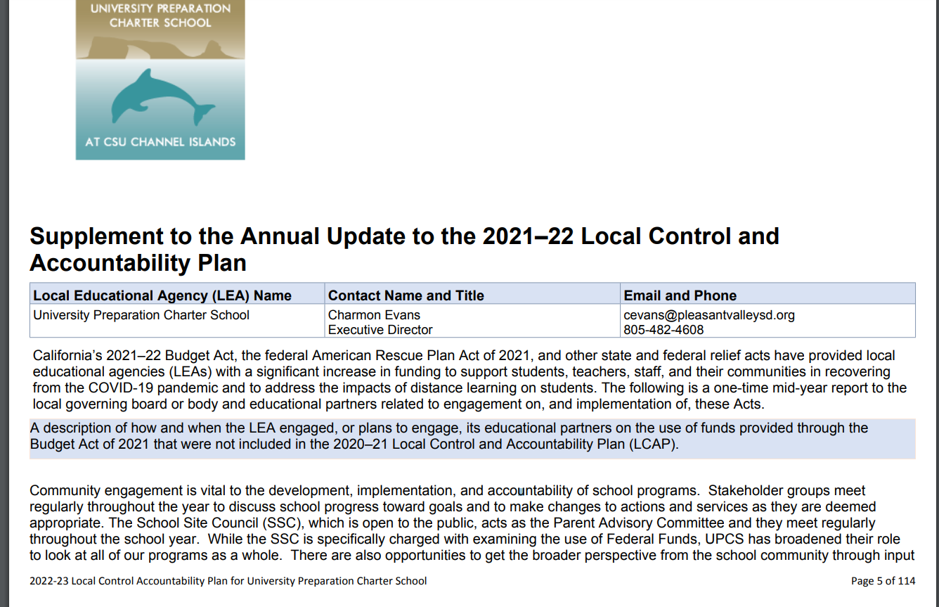
Mid-year Supplement

Slide 8

General Information
Ethnicity:
African American: 2%
American Indian or Alaska Native: .1%
Asian: 2%
Filipino: 2%
Hispanic or Latino: 77%
Pacific Islander: 0%
White: 14%
Two or More Races: 3%
Low Socio-Economic: Total Students: 302
Percentage of Total Population: 44.1%
Students with Disabilities: Total Students: 68
Percentage of Total Population: 10%
Homeless: Total Students: 19
Percentage of Total Population: 2.7%
Foster Youth: Total Students: 4
Percentage of Total Population: .5%
English Learners: Total Students: 105
Percentage of Total Population: 15%
Unduplicated Pupil Percentage 21-22 (UPP): 49.19%
Demographics as of Census Day: 10/6/2021
Total Students: 685

Slide 9
Successes
Climate Survey:
Students in grades 6-8 maintained or improved in several areas of feeling safe at school, belonging and peer collaboration, motivation, engagement and other data points collected on the climate survey.
Students in grade 3-5 maintained or improved in several factors related to their relationships here at school and on some feelings of safety at school.
Families closely maintained or improved in most areas regarding their overall feelings about the school.
We are still waiting on the following data to include:
Local assessment data will be entered prior to adoption of this document, teachers are still entering the data in the system
CAASPP data will be presented in the fall once it is received
ELPAC data will be presented in the fall once it is received

Slide 10
Identified Needs
Additional needs identified in 21-22
Climate Survey:
Students in grades 6-8 showed a decline in the following areas; treating each other with respect, specifically “feeling safe during school” and “feeling safe at home”, feelings of being ready for high school.
Students in grade 3-5 showed a decline in many areas of feeling safe at school. As we reflection this we can’t help but wonder if that is not because of the isolation and feelings of insecurity related to the pandemic.
We do not have the 21-22 CAASPP data but we did finally receive the 20-21 data and we can see deficits in both ELA and Math. We will report on the 21-22 CAASPP data as soon as it is released.
Local data will be added to this document before the adoption date as teachers are currently entering the data into our student data system and recording grades. At mid-year conferences teachers shared anecdotal data regarding the growth they were seeing in students.

Slide 11
LCAP Highlights
Changes to the 22-23 LCAP:
Goal 1: UPCS is reconceptualizing how intervention specialists are organized and utilized across the campus. In 21-22 much of the goals for intervention were thwarted due to staffing challenges. Utilizing learning recovery funds, UPCS will hire a fulltime intervention teacher to be assigned to each team. This intervention specialist will serve as a full member of their assigned teaching team and be able to participate in collaboration meetings, student study meetings, and specialize in specific grade level standards. The teams will gain flexibility in scheduling around the grade-levels specific bell schedule. The quantity and quality of intervention will be increased for students in 22-23.
Goal 2: In 21-22 administration and faculty spent time studying teacher resilence. An outcome of this work was refining the job embeded professional development time addressed in Goal 2, Action 1. Teachers will be given more individual profesisonal development time, IPD, that can be used for research, working on student data, and planning lessons to meet the needs of students. This additional time, to be used at the discretion of each teacher, will lead to higher teacher productivity and job satisfaction, which will directly affect the quality of education and outcomes for students.

Slide 12
Engagement
Educational partner engagement is vital to the development, implementation, and accountability of school programs. Educational partner groups need to meet throughout the year and have regular conversations about school progress toward goals and make changes to actions and services as they are deemed appropriate.
Meetings are designed to both explain the LCFF funding formula, including the focus on underserved populations, and to garner input from community members.
Opportunities for Engagement:
Coffee with the Directors
Family Survey
Student Survey
Staff Survey’s and meetings
Board Meetings
School Site Council (Parent Advisory Group)
English Learner Advisory Committee
Administration/Cabinet
Leadership Team

Slide 13
Engagement
Summary of feedback:
Continued need for intervention supports
Need to create systems that make the best use of intervention staff
More afterschool opportunities across the grades
Individual time for teachers to plan, prep, review student data, and study
Continued focus on social emotional support and resilience work

Slide 14
Engagement
22-23 changes to actions that were directly influenced by educational partner input:
Goal 1
Action 1 - We will employee more fulltime intervention teachers to be assigned to specific teams on campus. Each team will have more flexibility in how they schedule to work of their intervention teacher. The intervention teacher will be regular member of the team and be able to attend all planning and collaboration meetings, thus being better informed about the needs of the students at that grade level.
Action 3 - Summer School will have a academic focus than Summer 2021, but will still have the enrichment/SEL component
Goal 2
Action 1 - Teachers expressed the need to shift this to a focus on individual professional development and planning time. We will be hiring an additional PE teacher to provide each class with two times a week with the PE teacher, this will provide teachers in grades K-5 with two planning times a week. At middle school planning time will be provided with a prep period.
Action 8 - Increase in this area in order to bring a consultant on campus throughout the year to provide coaching and to include the consultant in regular leadership meetings as we continue the work around collective efficacy and broaden our work around student resilience and trauma informed practices
Action 10 - This is a new action item that will support the members of the leadership team as they dedicate time to the collaborative decision making process and increase student outcomes.
Goal 3
Action 10 - Increase to after school programs

Slide 15
LCAP Goal 1
UPCS will provide students with an education that will prepare them to contribute to society in positive ways and give them a solid foundation for college and/or career. UPCS will provide students with an education based on state standards matched with a broader perspective to include bilingualism, multicultural education, and a world view. UPCS understands that each student comes with their own unique gifts, strengths and challenges. UPCS will strive to close the achievement gaps experienced by SWD, ELLs, FY, and low-socio-economic status.
Academic Success

Slide 16
LCAP Goal 1 - Metrics
Metric | 2020-21 Baseline | Desired Outcome for 2023-24 | Status
DRA - Local Reading Assessment: Grades K-5 | Baseline scores will be established using beginning of year assessments given annually during the first two weeks of school and formatively throughout the year to progress monitor with an end of year assessment given to check achievement of metrics desired outcome. | In grades K-5: 80% of students will show, at minimum, a one year growth annually. Reduced by 25% the number of students working below grade level benchmarks. | End of year data is currently being uploaded and the new baseline will be created and data shared by the time of the LCAP adoption.
Local Reading Assessment: Grades 6-8 | To be established 2021-22 | To be established after assessment baseline given | Grade 6-8 each gave 10-12 DRAs for their lowest students. Data was collected using Achieve 3000 for comprehension. End of year data is currently being uploaded and the new baseline will be created and data shared by the time of the LCAP adoption.
Zone of Biliteracy (using local assessments in Spanish): Dual Students in Grades K-8 | To be established in 2021. A team will establish criteria for benchmarks using local Spanish Assessments. | Students in dual immersion will make 1 year of growth in Language Acquisition annually toward biliteracy goals. | After reviewing research, the team revised the conference guide to communicate growth in student's English and Spanish reading. In the display of reading levels, an indication of benchmarks for students in a monolingual program is included as a reference for typical development of monolingual peers.

Slide 17
LCAP Goal 1 - Metrics
Metric | 2020-21 Baseline | Desired Outcome for 2023-24 | Status
CAASPP ELA: Grades 3-8 | 2018-2019 scores Points from Standard All: 3 points below standard Students with Disabilities: 72.8 below English Learners: 41 below Hispanic: 15.4 below White: 35.3 above African American: 4.5 above Filipino: 37.7 above Homeless: 37.2 below Socioeconomically Disadvantaged: 25.6 below Dashboard: Green: All Students, White Yellow: English Learners, Socioeconomically Disadvantaged, Hispanic Red: Student with Disabilities – MET/EXCEED - 29% – MET/EXCEED - 33% – MET/EXCEED - 53% – MET/EXCEED – 48% – MET/EXCEED – 65% – MET/EXCEED – 45% | Points from standard: All students: maintain at or above Students with Disabilities: Improve by 50% English Learners: Improve by 50% Hispanic: Improve by 50% White: Maintain at or above African American: Maintain at or above Filipino: Maintain at or above Homeless: Improve by 50% Socioeconomically Disadvantaged: Improve by 50% All Subgroups in Red, Orange to improve by at least one color. | Waiting on the release of the 21-22 Test scores. This indicator will be reported on when the data arrives.

Slide 18
LCAP Goal 1 - Metrics
Metric | 2020-21 Baseline | Desired Outcome for 2023-24 | Status
Local Writing Assessment | To be established in 2021-22 | Establish after baseline | The metric will be pushed out to create a new baseline in 22-23 school year. Teachers continued with previous assessment tools from various sources.
Local math summative assessments: Grades K-8 | To be established in 2021-22 | Establish after baseline | This metric is redundant and unnecessary based on the MAC/MARS and state testing.

Slide 19
LCAP Goal 1 - Metrics
Metric | 2020-21 Baseline | Outcome for 23/24 | Status
MAC/MARS local math performance assessments given 3X's a year: Grades K-8 | Teachers gave performance assessments three times this year in grades K-5 and twice this year in grades 6-8. The tool we used this year was MAC/MARS assessments. Teachers found many of these assessments to be cumbersome and time consuming for students. Next year we will explore different suite of math assessments that better meet the needs of our community. | Establish and administer a math performance assessment three times a year to guide instruction. | Teams have determined common MAC/MARS assessments to give as follows: Kindergarten Trimester 1: MAC 21 Booklet Revised Trimester 2: MAC Kinder Summative Revised Trimester 3: MAC 2021 Kindergarten Exam Booklet 1st Grade Trimester 1: MARS Writing Equations Trimester 2: Grade 1: Summative Trimester 3: MARS Writing Equations 2nd Grade Trimester 1: Grade 2 Summative Performance Assessment Trimester 2: Grade 2 Summative Spring Trimester 3: Grade 2 Summative Performance Assessment 3rd Grade Trimester 1: Grade 3 Performance Assessment Spring 2021 Trimester 2: Grade 3 Summative Spring Trimester 3: Grade 3 Performance Assessment Spring 2021 4th Grade Trimester 1: Grade 3 Performance Assessment Spring 2021 Trimester 2: MARS “Donna’s Candy Shop” Trimester 3: Grade 4 Performance Assessment Spring 2021 5th Grade Trimester 1: Grade 4 Performance Assessment Spring 2021 Trimester 2: MARS “Rocket Launch Celebration” Trimester 3: Grade 5 Performance Assessment Spring 2021 6th Grade Trimester 1: Decimal Operations (At the Grocery Store) and Fraction Concepts Trimester 2: MAC/MARS Spring Summative Trimester 3: 7th Grade Trimester 1: Ratios and Proportional Relationships and Expressions and Equations Trimester 2: MAC/MARS Spring Summative Trimester 3: 8th Grade Trimester 1: Ratios and Proportional Relationships and Expressions and Equations Trimester 2: MAC/MARS Spring Summative Trimester 3:

Slide 20
LCAP Goal 1 - Metrics
Metric | 2020-21 Baseline | Desired Outcome for 2023-24 | Status
CAASPP Math: Grades 3-8 | 2019 Scores Points from Standard All: 31.6 below Students with Disabilities: 109.6 below English Learners: 60.5 below Hispanic: 43.7 below White: 6.1 above African American: 60.4 below Filipino: 22.5 above Homeless: 54.6 below Socioeconomically Disadvantaged: 52.3 below Dashboard: Green: White Yellow: Socioeconomically Disadvantaged Orange: All Students, English Learners, Hispanic Red: Student with Disabilities – MET/EXCEED - 33% – MET/EXCEED - 29% – MET/EXCEED - 39% – MET/EXCEED – 35% – MET/EXCEED – 34% – MET/EXCEED – 33% | Points from standard: All students: Improve by 50% Students with Disabilities: Improve by 50% English Learners: Improve by 50% Hispanic: Improve by 50% White: Maintain at or above African American: Maintain at or above Filipino: Maintain at or above Homeless: Improve by 50% Socioeconomically Disadvantaged: Improve by 50% All Subgroups in Red, Orange to improve by at least one color. | Waiting on the release of the 21-22 Test scores. This indicator will be reported on when the data arrives.

Slide 21
LCAP Goal 1 - Metrics
Metric | 2020-21 Baseline | Desired Outcome for 2023-24 | Status
Local Science Assessments: Grades K-8 | To be established in 21-22 | At minimum 75% or students able to demonstrate proficiency on local science assessments. Grades K-8 | This metric will begin in 22-23
CAST state Science Assessment: Grades 5 and 8 | 2019 Scores 5 - MET/EXCEED - 34.57% 8 - MET/EXCEED - 40% | Increase met/exceed by 15% | Waiting on the release of the 21-22 Test scores. This indicator will be reported on when the data arrives.
ELPAC: Progress towards Proficiency English Learners in Grades K-8 | Waiting on 20-21 data. 2020-2021 Data Overall by level Level 4 - 22.11% -4.42% Level 3 - 43.16% +1.32% Level 2 - 27.27% +5.84% Level 1 - 7.37% - 2.83 Homeless There were not enough students in the this subgroup to allow for data to be published Because there was no Dashboard data for 20-21 we do not have an ELPI level to compare. Students are currently taking the 21-22 ELPAC | Maintain a rate equal or higher than the state average on the ELPAC. Homeless Students: Decrease the % of students in Levels 1 and 2, Increase in students in Levels 3 and 4. | Waiting on the disaggregation of the 21-22 test results. This indicator will be reported on when the data arrives.

Slide 22
LCAP Goal 1 - Metrics
Metric | 2020-21 Baseline | Desired Outcome for 2023-24 | Status
ELPAC: Reclassification Rate English Learners in Grades K-8 | 2018-2019: 11.6% 2019-2020: 33.6% 2020-2021: 3.3% Over the last several years the state has been working on the new ELPAC assessment and creating statewide baselines. For UPCS this has fluctuated a lot over the last several years, so we will take an average to create a baseline: 16% Redesignation Rate | Increase by 30% | We reclassified 2% at the time of this report.
Physical Fitness Test Grades 5 and 7 | The PFT hasn’t been administered since spring 2018 and at the time of this report the PFT website wasn't working properly. We will use the 21-22 year to create a new baseline. | Determine after baseline in 21-22 | The PFT was administered to all 5th and 7th grade students. The state is making a shift in this assessment and we are no longer reporting on this data. We will not establish a benchmark at this time, but rather wait until the state makes a decision on what direction they will be going in for physical fitness.

Slide 23
LCAP Goal 1 - Metrics
Metric | 2020-21 Baseline | Desired Outcome for 2023-24 | Status
Instructional Materials Student have access to standards aligned instructional materials and instruction | No complaints Met Local Indicator 1 - Spring 2021 | Charter Schools are not subject to the Williams ACT, but UPCS will provide students with access to state standards aligned instructional materials. Met on Local Indicator 1 | Met
Implementation of CA State Standards, including how ELs access CCSS and ELD Standards | Met Local Indicator 2 - Spring 2021 | Met on Local Indicator 2 | Met

Slide 24
LCAP GOAL 1 – FUNDED ACTION 22-23
ACTION TITLE/DESCRIPTION | BUDGETED EXPENDITURE
Intervention Program Staffing | $410,308
Additional Teacher to assist Multi-grade classes | N/A
Summer School 2021 | $93,568
Additional Instructional Aide | $37,000
CCSS and NGSS aligned programs/materials | $50,000
Transportation to After School Program | $85,000
Supplemental Services for Long Term Els | $9,440
Additional Instructional Aide for SPED | $7,912
Technology | $26,292
Materials to support ELA | $26,000

Slide 25
LCAP Goal 2
UPCS will nurture an environment where lifelong learning and growth is valued and modeled by faculty and staff. The continued professional growth of faculty and staff will result in a higher quality educational experiences and outcomes for UPCS students. Learning will focus on the unique needs of unduplicated students, English Learners, low socio-economic, foster youth and students with disabilities. Collaborative learning experiences centered on meeting the diverse needs of our students will strengthen teacher and collective efficacy and resiliency.
Professional Development

Slide 26
LCAP Goal 2 - Metrics
Metric | 2020-21 Baseline | Desired Outcome for 2023-24 | Status
Annual Faculty Survey | Administered Spring 2021 | Survey given annually and results used as a needs assessment to evaluate program effectiveness and guide future work and initiatives | Abbreviated version given spring 2022. Data used to make decisions on instructional tools. Teacher team interviews used to make decisions on curriculum.
New faculty participate in the induction program | 100% of new faculty participated in 20-21 | 100% of new faculty supported to complete induction in two years | All new faculty participated in induction.
The Enabling Conditions for Collective Teacher Efficacy Questionnaire | Baseline established in the fall of 2021-22 – see LCAP for more details | Goals for 23-24 will be established after end of year data is collected for 21-22 | Positive movement toward the highest level of collaboration was made over the course of the school year.
Ladder of Teacher Involvement in School Decision Making | Baseline established in the fall of 2021-22 – see LCAP for more details | Goals for 23-24 will be established after end of year data is collected for 21-22 | Positive movement up the ladder was made over the course of the school year.
Fully credentialed and appropriately assigned teachers | For 20-21: 6 Charter Allowed 1 Misassigned The CalSaas review for 21-22 hasn’t been conducted. | 100% of faculty fully credentialed and appropriately assigned | The 21-22 official data is not processed, but it looks like we will have on 1 teacher who will fall under the new charter school rules and no other misassignments. We will report on this after the audit and the data is finally confirmed.

Slide 27
LCAP GOAL 2 – FUNDED ACTION 22-23
ACTION TITLE/DESCRIPTION | BUDGETED EXPENDITURE
Learning Partnership PD | $181,500
Recruit and retain highly qualified bilingual teachers | $21,000
New Teacher Induction | $12,000
Professional Development for standards | $18,271
Instructional Coaches | $118,154.63
Professional Development for English Learners | $2,000
Language Acquisition Team | $2,000
PD on resilience and trauma informed practice | $40,000
Stipends for Summer Collaboration | $26,500
Leadership Team | $6,300

Slide 28
LCAP Goal 3
UPCS will provide a learning environment that fosters a sense of interconnectedness, belonging, safety, creativity and inclusiveness for students, teachers, and families. Supporting the whole child is a focus for UPCS. Students' social and emotional needs should be addressed proactively with supports in place for moments of crisis. Providing all students with opportunities to participate in enrichment classes focused on life skills, the arts, science and engineering, and other areas of student interests broadens students' experience quotient. This is especially significant for our SWD, ELL's, FY, and low socio-economic students. Connectedness also applies to the home-school connection and the impact it has on student success.
Social Emotional

Slide 29
LCAP Goal 3 - Metrics
Metric | 2020-21 Baseline | Desired Outcome for 2023-24 | Stauts
SEL Screening Tool | As a screening tool there will be no baseline. | Screening tool is given annually at the beginning of the year. | Grades K and 1 completed the Walker Survey for all students in September 21.

Slide 30
LCAP Goal 3 - Metrics
Metric | Baseline | Desired Outcome 23-24 | Status
Student Climate Survey | 2022 Baseline Grades 6-8 Enjoy School Most of the time: Low Income 49% English Learners 73% Special Education 54% My teachers expectations make me want to do my best. Low Income 64% English Learners 80% Special Education 72% The work that I do for my classes makes me really think. Low Income 64% English Learners 85% Special Education 61% My teachers explain things in a way I can understand Low Income 67% English Learners 74% Special Education 71% My teachers give me assignments that really help me learn Low Income 57% English Learners 72% Special Education 54% I feel like I will be ready for High School Low Income 50% English Learners 65% Special Education 57% Do you want to go to college? Low Income 69% English Learners 65% Special Education 73% I feel like a part of the school community Low Income 62% English Learners 74% Special Education 69% During this school year, have other students bullied or harassed you? Low Income 18% English Learners 9% Special Education 17% In my school there is at least one adult who would be willing to help me with a personal problem Low Income 48% English Learners 47% Special Education 40% When I'm feeling upset, stressed, or having problems, there is an adult from school who I can talk to about it Low Income 45% English Learners 44% Special Education 39% | Maintain or Improve | We created a new baseline. Unfortunately, we found out after the survey was given that Youth Truth had stopped disaggregating data utilizing our Student Information System during COVID because of distance learning. They did not turn that functionality back on this year. The subgroups were self-identified by our middle school students. 3-5 grade students were not given the option to self identify. Next year we will have the data pulled from our student information system and may reset the baseline utilizing next years data.

Slide 31
LCAP Goal 3 - Metrics
Metric | 2020-21 Baseline | Desired Outcome for 2023-24 | Status
Attendance Rates | ADA for 19-20 through March 13, 2020 was 96% ADA for 20-21 as reported in P2 was 97% | Maintain 96% ADA | 94%
Chronic Absenteeism | In 20-21 we had 37 students considered chronically absent which was an improvement from the 19-20 school year with 65. | Improve rates | 77 Students were considered chronically absent
Suspension/Expulsion Rates | 19/20 – 7 Suspensions 0 Expulsions 20/21 – 0 Suspensions 0 Expulsions | Maintain or Improve | There were 12 suspensions reported as of the day this report was completed for 21-22. There were 0 students expelled. It was evident that the pandemic has had a social emotional and behavioral toll on students. We saw an increase in students having behavioural challenges and conflict with others.
Access to Broad Course of Study | 100% of students have access to a broad course of study Met on Local Indicator 7 Spring 2021 | 100% of students have access to a broad course of study Met on Local Indicator 7 | 100% of students have access to a broad course of study. Met on Local Indicator 7 Spring 2022

Slide 32
LCAP Goal 3 - Metrics
Metric | 2020-21 Baseline | Desired Outcome for 2023-24 | Status
Family Survey – School Connectedness/Safety | I feel Engaged: 2019: 3.98/4.56; 2020: 3.89/4.56; 2021: 3.88/4.65 I feel informed: 2019: 3.80/4.55; 2020: 3.96/4.55; 2021: 3.95/4.55 Included in Planning School Activities: 2019 4.02/2.50; 2020: 4.03/4.50; 2021: 3.94/4.50 I feel represented by parent/family groups: 2019: 3.98/4.90; 2020: 3.88/4.90; 2021: 3.78/4.90 I feel empowered to play a meaningful role: 2019: 3.70/4.4; 2020: 3.57/4.4; 2021: 3.67/4.40 School admin treat families with respect: 2019: 4.12/4.75; 2020: 4.17/4.75; 2021: 4.19/4.75 Teachers treat families with respect; 2019: 4.35/4.75; 2020: 4.43/4.75; 2021: 4.35/4.75 I feel comfortable approaching school admin with concerns: 2019: 4.02/4.73; 2020: 4.19/4.73; 2021: 4.21/4.73 I feel comfortable approaching my child’s teacher: 2019: 4.33/4.73; 2020: 4.49/4.73: 2021: 4.36/4.73 School Policies are administered fairly and consistently: 2019: 3.9/4.55; 2020: 3.97/4.55; 2021: 4.02/4.55 My school runs smoothly: 2019: 3.93/4.75: 2020: 4.09/4.75; 2021: 3.99/4.75 I am proud of my school: 2019: 4.23/4.7; 2020: 4.28/4.7; 4.18/4.7 My school creates a friendly environment: 2019: 4.15/5; 2020: 4.24/5; 2021: 4.31/5 I feel valued at my school: 2019: 4.05/4.65; 2020: 3.94/4.65; 2021: 3.98/4.65 Discipline is fair 2019: 3.68/4.6; 2020: 3.87/4.6; 2021: 3.85/4.6 | Maintain or Improve | On the family survey we saw most areas remain fairly the same. Administrators treat families with respect. 2022 - 4.13/4/75 Teachers treat families with respect. 2022 - 4.31/4/75 Teachers and students care about each other. 2022 - 4.30/4/73 Families and teachers care about each other. 2022 - 4.27/4.62 I feel comfortable approaching the administration about my concerns. 2022 - 4.14/4.73 I feel comfortable approaching teachers about my child's progress. 2022 - 4.35/4.73 My school runs smoothly. 2022 - 4.11/4/75

Slide 33
LCAP Goal 3 - Metrics
Metric | 2020-21 Baseline | Desired Outcome for 2023-24 | Status
Schools Site Council and English Learner Advisory Committee | 8 SSC Meetings in 20-21 7 ELAC Meetings in 20-21 | Minimum of 7 Meetings Annually | 4 SSC Meetings 3 ELAC Meetings
Family Nights | 19-20 7 Family Information Nights 8 Coffee with the Directors | Minimum of 5 Family Engagement Minimum of 7 Coffee with the Directors | We were able to hold 6 Coffee with the Directors once families were allowed back on campus. We held 5 Family Education Nights.
FIT report; clean, safe and functional facitilities | Good Repair | Maintain | Report in August 2021 was Good Repair
Parent participation in programs for English Learners, Low-Income and Foster-Youth students | Met – Local Indicator – Spring 2021 | Met on Local Indicator 3 | Met on Local Indicator 3
Local Indicator 6 School Climate | Met – Local Indicator 6 – Spring 2021 | Met on Local Indicator 6 | Met on Local Indicator 6

Slide 34
LCAP GOAL 3 – FUNDED ACTION 22-23
ACTION TITLE/DESCRIPTION | BUDGETED EXPENDITURE
Social/Emotional Curriculum Supports | $20,219
Counseling Services | $132,721.20
Increase to school Psychologist Contract | $18,000
SEL supports in and out of the classroom | $9,500
Enrichment programs | $104,865.33
Classroom Furniture and Library Furniture | N/A
Family Engagement and Education | $14,328.11
Library Personnel | $12,700
Spanish Enrichment Program | $47,700
After School Clubs | $280,000

Slide 35
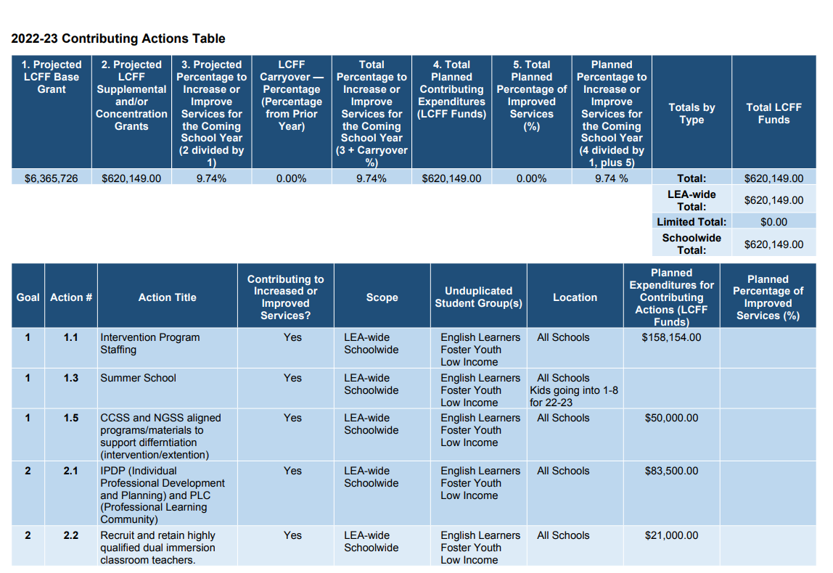

Slide 36
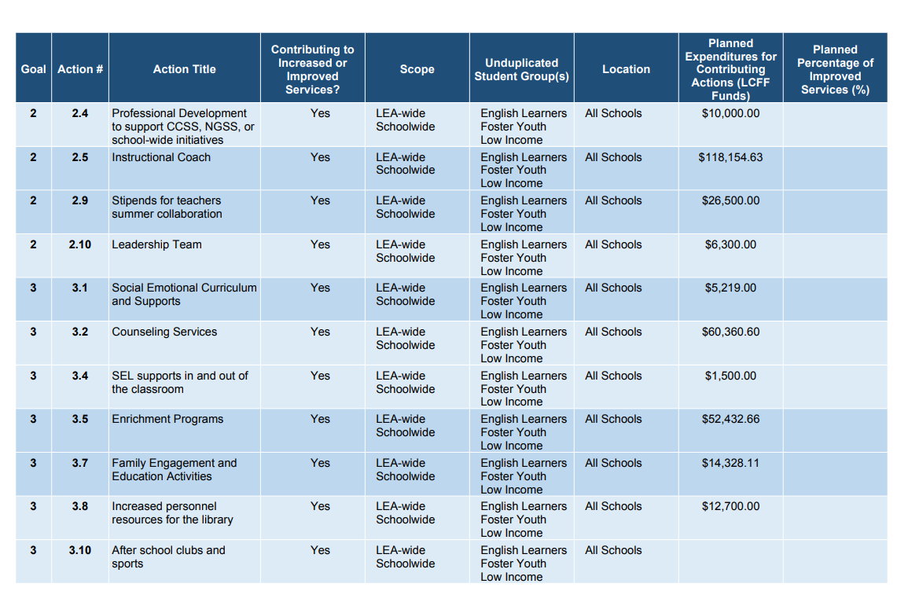

Slide 37

Dolphin Strong!

